Slide 1
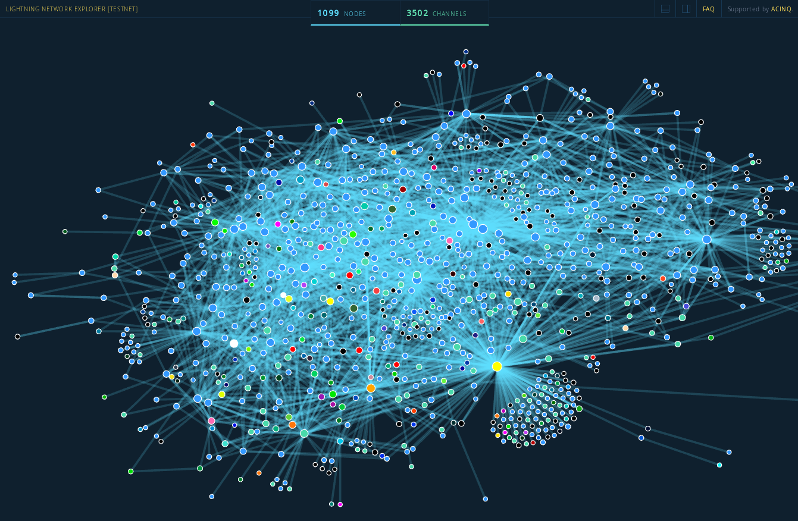
⚡ The Lightning Network ⚡
By Sachin Meier

Slide 2
What it is

Slide 3
How it solves Scaling Issues

Slide 4
Running Lightning

Slide 5
Liquidity
The LN Trust Chain
#LNTrustChain
#Reckless
Each channel is bidirectional (1 on 1) so each new channel requires funding

Slide 6
How will it work globally?
Local networks,
Instant paychecks, not biweekly?

Slide 7
More Layers?

